Slide 1

Three letter words …
Loading … 47%
(Week #8 of 17)
Weekly demo
Arnold BARNA
2017-11-03
MVC, SQL, etc.

Slide 2
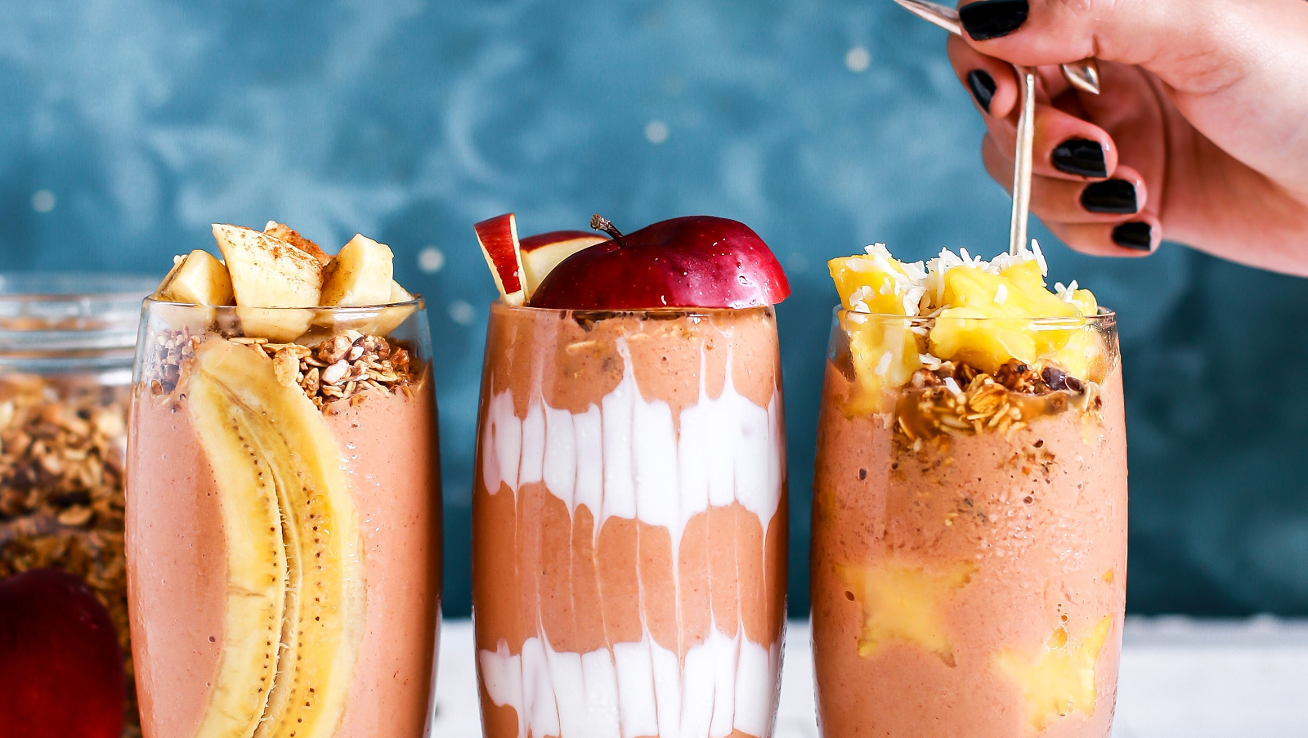
What Doesn't Kill You Makes You Stronger

Slide 3

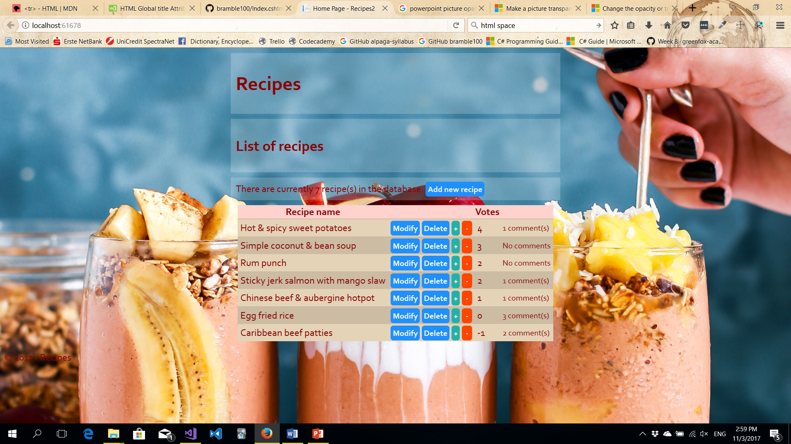

Recipe Collecting WebApp with SQL

Slide 4
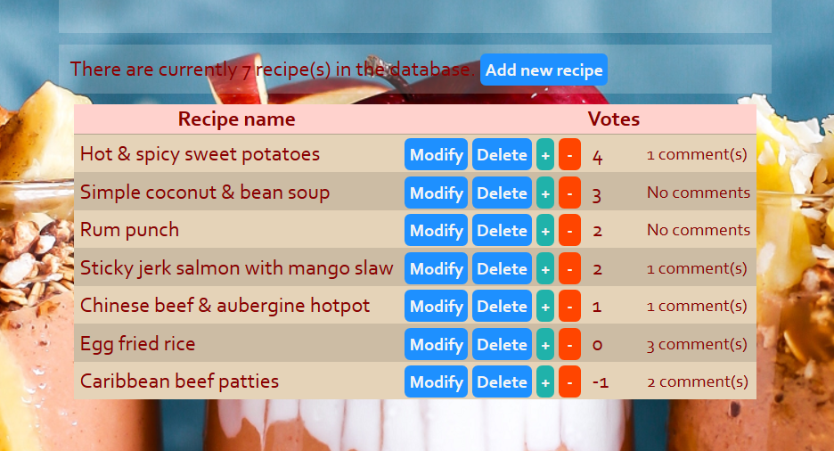
Closeup on Result Screenshot

Slide 5
ViewModel for View
Two objects to show:
Recipe data (name, popularity)
Comments data (sum of comments grouped by recipe)
They come from different SQL tables
They had to be packaged into one ViewModel object

Slide 6
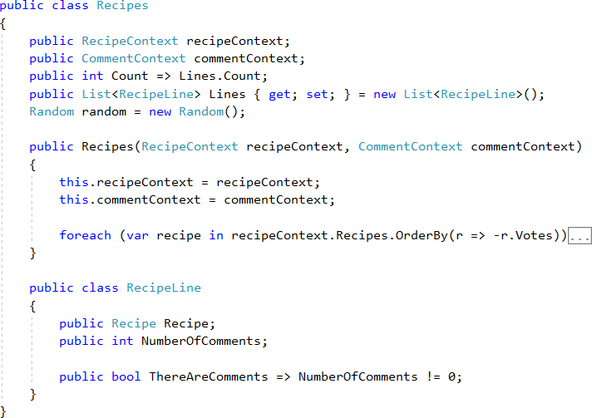
ViewModel for View

Slide 7
What works now
Operates seamlessly with the MS-SQL database
Lists all the recipes, ordered by popularity
Add new ones
Edittt exysting ones
Delete existing ones
Vote them ^{up} and _{down}

Slide 8
Plans for the future
All the bells and whistles
Add Comments
Action history
Recipes, ingredients behind
Shovel it all up to Heroku
Or just survive the next (9th) week

Slide 9
Thank you for the attention
Available on GitHub:
Code:
https://github.com/greenfox-academy/bramble100/tree/master/week-08/
Slides:
https://github.com/greenfox-academy/bramble100/tree/master/week-08/demo

